Slide 1
Parallelism in Haskell
awaw

Slide 2
Parallelism & Concurrency
Synonyms in many fields, but not so in programming
Parallelism – about efficiency, can be achieved via deterministic and nondeterministic methods, but determinism is preferred
Concurrency – a programming technique in which there are multiple threads of control. Necessarily nondeterministic

Slide 3
Parallelism (nondetermistic)
Ex: Find the letter that has 100 words that start with it in a file
Randomly pick a strategy to start first
Filter ‘a’ from
beginning of file
Filter ‘a’ from
end of file
Filter ‘b’ from
beginning of file
Filter ‘b’ from
end of file

Slide 4
Parallelism
Ex: Find the letter that has 100 words that start with it in a file
Filter startWith ‘a’
Filter startWith ‘b’

Slide 5
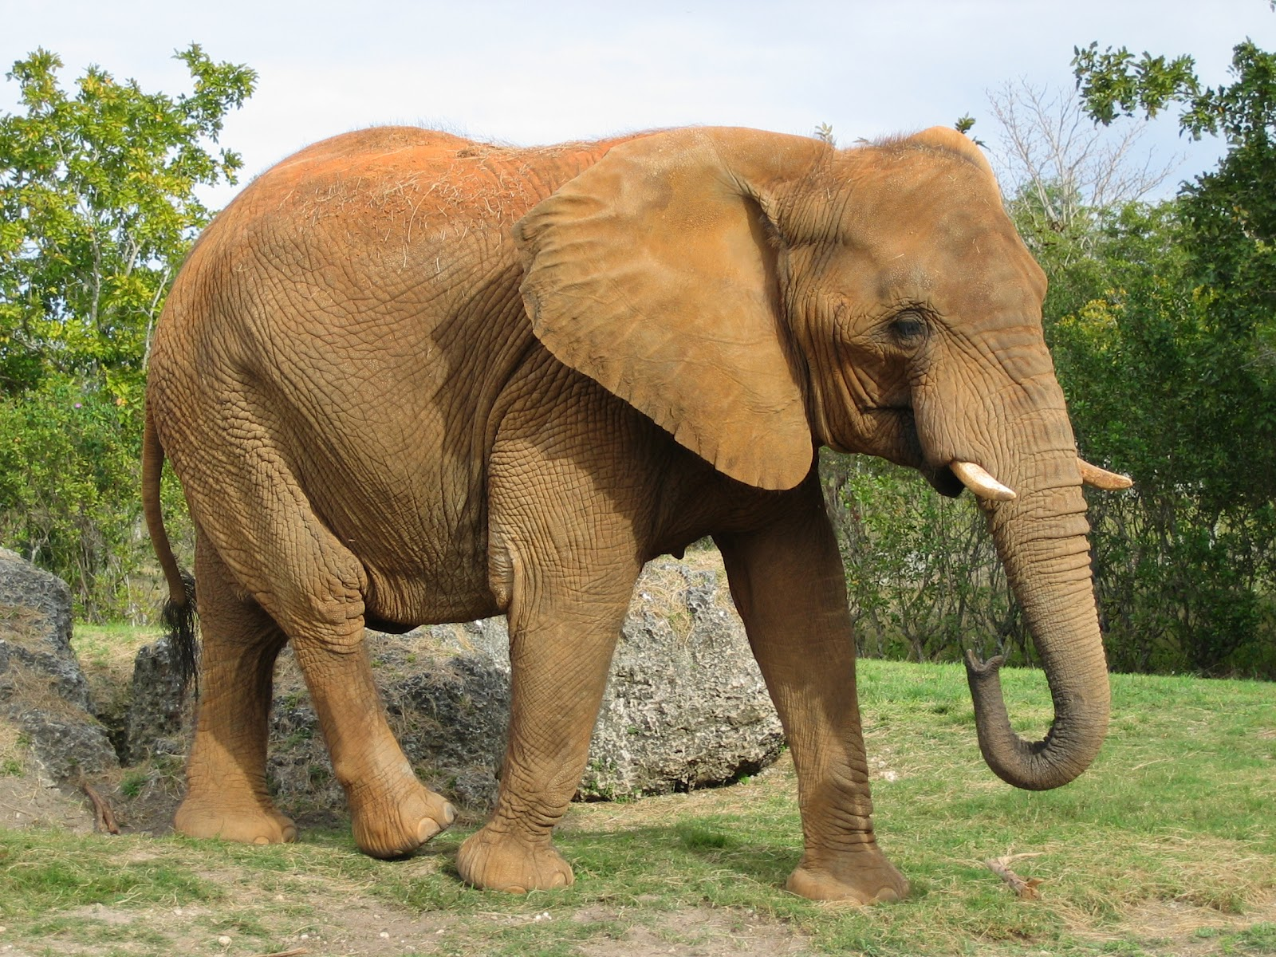
Parallelism & Concurrency in Haskell
Eval monad
Asynchronous Exceptions
a
Par monad
MVar
STM, Software Transaction Memory
Strategies

Slide 6
Motivation
Problems
Keys stored in Redis
Cleanup of textual data

Slide 7
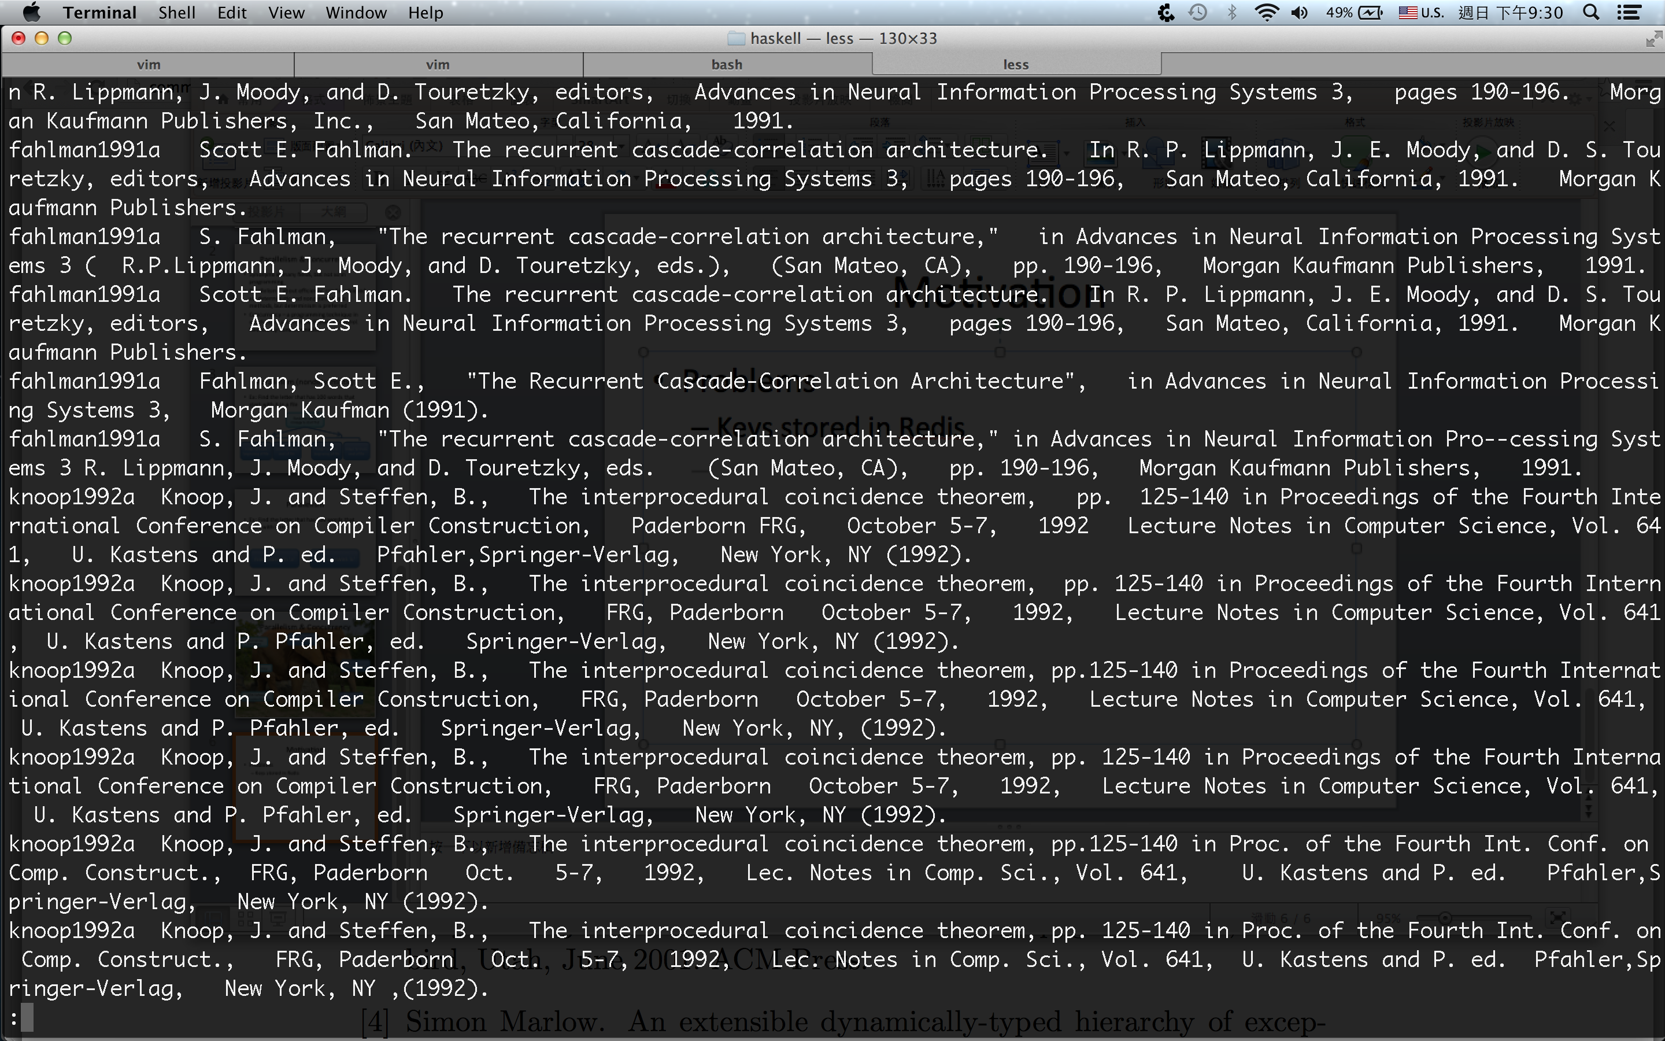
Motivation
Problems
Keys stored in Redis

Slide 8
Motivation
Problems
Keys stored in Redis
Cleanup of textual data
Solution:
Damerau-Levenshtein distance
K-medoids algorithm

Slide 9
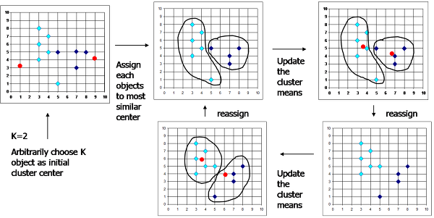
Motivation
K-medoids algorithm

Slide 10
Eval monad
Control.Parallel.Strategies
data Eval a
instance Monad Eval
runEval :: Eval a -> a
rpar :: a -> Eval a
-- `a` could be evaluated in parallel
rseq :: a -> Eval a
-- evaluate `a` and wait for the result
-- in both cases, evaluation is to
-- weak normal form

Slide 11
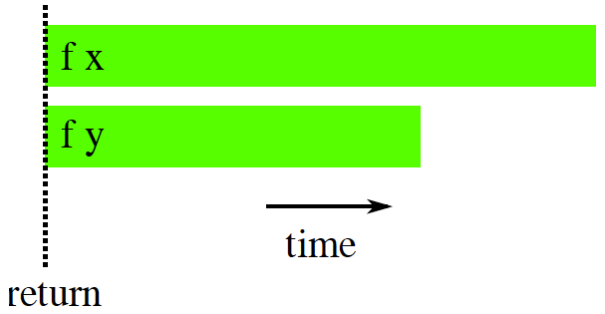
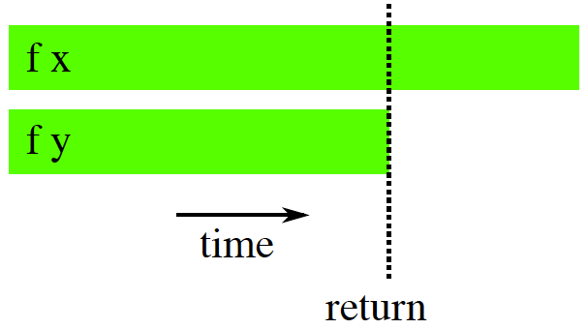
1. Eval monad
do a <- rpar (f x)
b <- rpar (f y)
return (a,b)
do a <- rpar (f x)
b <- rseq (f y)
return (a,b)

Slide 12
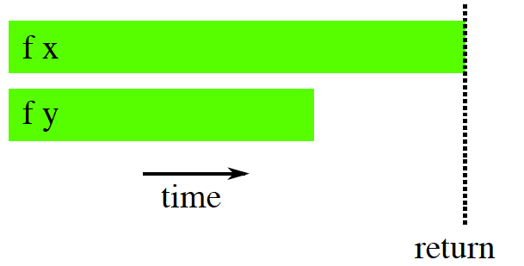
1. Eval monad
do a <- rpar (f x)
b <- rseq (f y)
rseq a
return (a,b)
do a <- rpar (f x)
b <- rpar (f y)
rseq a
rseq b
return (a,b)

Slide 13
2. Strategies
type Strategy a = a -> Eval a
rseq :: Strategy a
rpar :: Strategy a
using :: a -> Strategy a -> a
x `using` s = runEval (s x)
parMap strat f xs = map f xs `using` parList strat
parList :: Strategy a -> Strategy [a]
parList strat [] = return []
parList strat (x:xs) = do
x’ <- rparWith strat x
xs’ <- parList strat xs
return (x’:xs’)
Take away recipe:
map f xs
parMap rdeepseq f xs

Slide 14
3. Par monad
Control.Monad.Par
newtype Par a
instance Functor Par
instance Applicative Par
instance Monad Par
runPar :: Par a -> a
fork :: Par () -> Par ()
data IVar a –- instance Eq
new :: Par (Ivar a)
put :: NFData a => IVar a -> a -> Par ()
get :: Ivar a -> Par a

Slide 15
3. Par monad
do
a’ <- spawn (f x)
b’ <- spawn (f y)
a <- get a’
b <- get b’
return (a,b)
Q: Looks so similar to Eval monad,
why bother to have another library that does the same thing?
Ans:
* Using the Eval monad requires some understanding of
the workings of lazy evaluation. Newcomers find this hard, and
diagnosing problems can be difficult
* Programming with rpar requires being careful about retaining
references to sparks to avoid them being garbage collected;
this can be subtle and hard to get right in some cases

Slide 16
Caveats of Haskell parallelism
Well known

Slide 17
Spark conversions
Converted: what we want!
Overflowed
the spark pool has a fixed size, and if we try to create sparks when the pool is full, they are dropped and counted as overflowed
Dud
when `rpar` is applied to an expression that is already evaluated, this is counted as a dud and the rpar is ignored
GC’d
the spark expressed was found to be unused by the program, so the runtime removed the spark
Fizzled
the sparked expression was initially unevaluated, but later became evaluated. Fizzled sparks are removed from the spark pool

Slide 18
Eval monad caveats – GC’d sparks
-- Correct implementation
parList strat [] = return []
parList strat (x:xs) = do
x’ <- rparWith strat x
xs’ <- parList strat xs
return (x’:xs’)
-- Buggy implementation
parList :: Strategy a -> Strategy [a]
parList strat xs = do
go xs
return xs
where
go [] = return ()
go (x:xs) = do rparWith strat x
go xs
Not tail-recursive,
that means it requires stack space linear in the length of the input list

Slide 19
Eval monad caveats – GC’d sparks
But, running the buggy implementation gives
This is because the runtime automatically discards unreferenced sparks
SPARKS: 1000 (2 converted, 0 overflowed, 0 dud, 998 GC’d, 0 fizzled)
do
…
rpar (f x)
…
do
…
y <- rpar (f x)
… y …
do
…
rpar y
…
Might be OK,
As long as y is required by
the program somewhere
Wrong!
Correct

Slide 20
Eval monad caveats – forget to `force`
do
a <- rpar (force (map solve as))
b <- rpar (force (map solve bs))
rseq a
rseq b
return (a,b)
Notes:
ghc -O2 sudoku2.hs -threaded -eventlog -rtsopts; time ./sudoku2 sudoku17.1000.txt +RTS -N2 -lf > eee

Slide 21
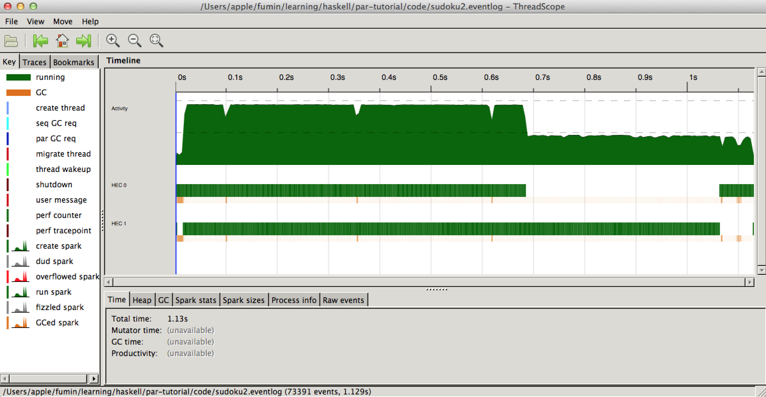
Eval monad caveats – forget to `force`
do
a <- rpar (deep (map solve as))
b <- rpar (deep (map solve bs))
rseq a
rseq b
return (a,b)

Slide 22
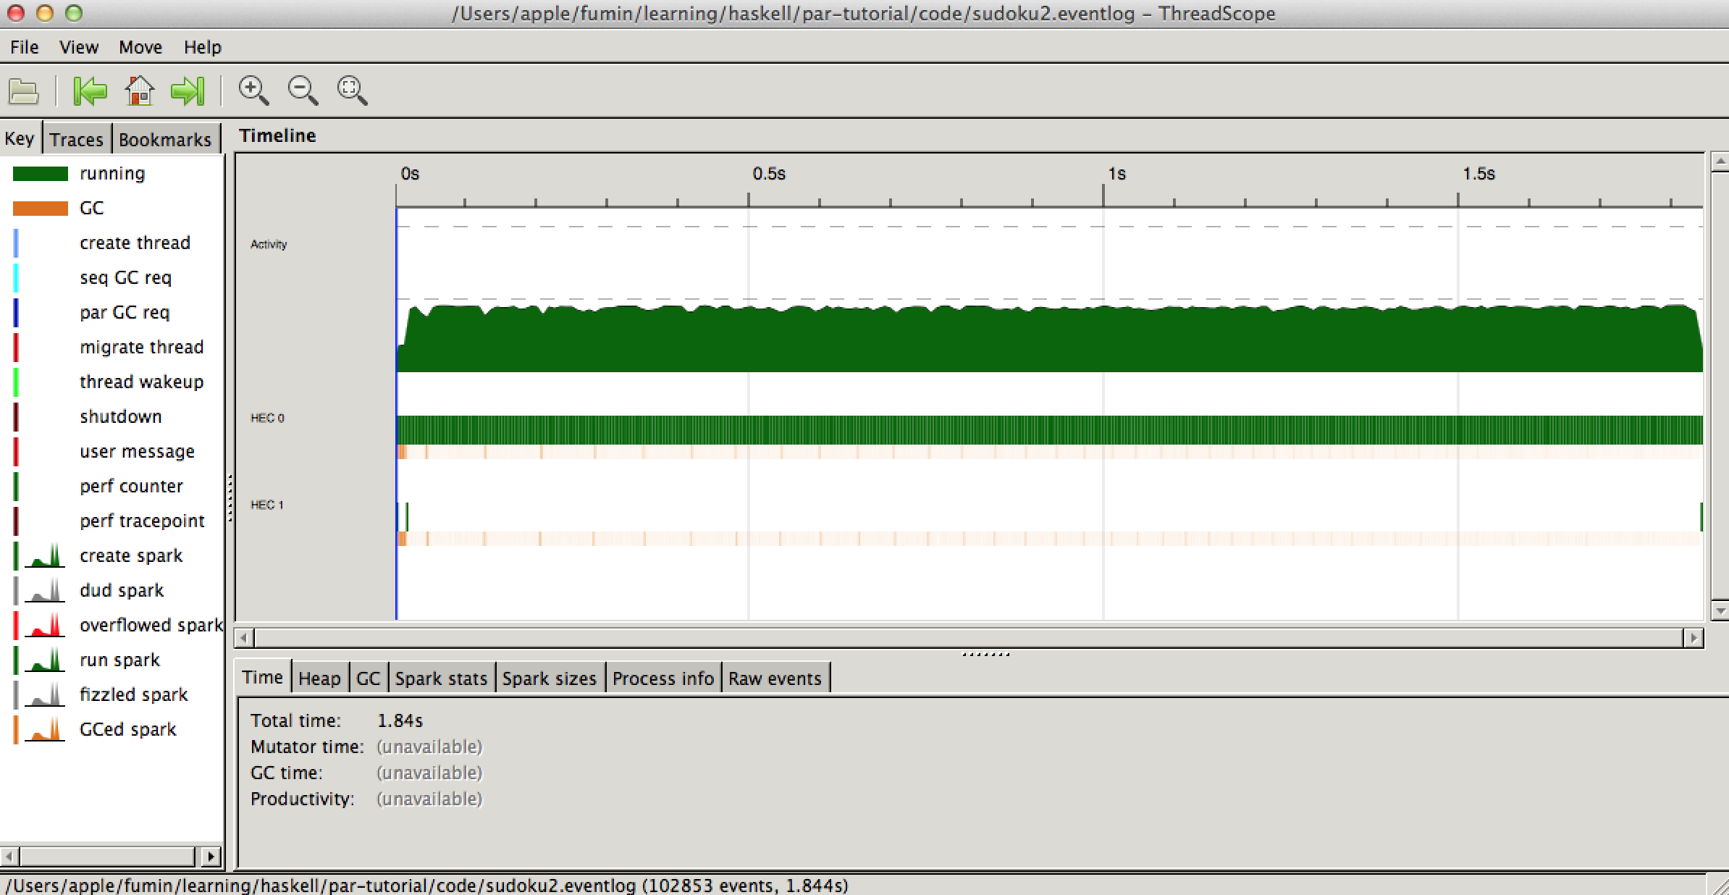
Eval monad caveats – forget to `force`
do
a <- rpar (deep (map solve as))
b <- rpar (deep (map solve bs))
rseq a
rseq b
return (a,b)

Slide 23
Caveats of Haskell parallelism
Less known

Slide 24
Par monad caveat – Divide & Conquer
-- buggy implementation
dAndC xs
| granularity > (length xs) = ourLogic xs
| otherwise = runPar $ do
[i1,i2] <- replicateM 2 new
fork $ put i1 $ dAndC as
fork $ put i2 $ dAndC bs
as’ <- get i1
bs’ <- get i2
return $ combine as’ bs’
where (as,bs) = splitAt (length points `div` 2)
points
recursion

Slide 25
Par monad caveat – Divide & Conquer
-- correct implementation
dAndC xs = runPar $ mDAndC xs
mDAndC xs
| granularity > (length xs) =
return $ ourLogic xs
| otherwise = do
i1 <- spawn $ mDAndC as
i2 <- spawn $ mDAndC bs
as’ <- get i1
bs’ <- get i2
return $ combine as’ bs’
where (as,bs) = splitAt (length points `div`)
points

Slide 26
Par monad caveat – Divide & Conquer
Buggy implementation: takes 2m27.661s !
Correct implementation: takes 0m10.140s
Explanation:
The buggy implementation recursively calls `runPar`, whereas the correctly implementation calls it only once
`runPar` is more expensive than `runEval` because
It waits for all its subtasks to finish before returning (necessary for determinism)
It fires up a new gang of N threads and creates scheduling data structures

Slide 27
Data flow V.S. Equational reasoning & Lazy evaluation
main = do
let distMap = computeDistances strings
state’ = EM.em_restarts … distMap
em_restarts … distMap =
argmin variance states
where states = parMap rdeepseq runEM
runEM = em . initEMState … distMap
SPARKS: 4270 (1912 converted, 0 overflowed, 0 dud, 1494 GC’d 864 fizzled)

Slide 28
Data flow V.S. Equational reasoning & Lazy evaluation
main = do
let distMap = computeDistances strings
state’ = EM.em_restarts … distMap
em_restarts … distMap =
argmin variance ((EMState … v):states)
-- argmin variance states
where states = parMap rdeepseq runEM
runEM = em . initEMState … distMap
v = (sum $
parMap rdeepseq variance states) - 1
SPARKS: 2728 (1934 converted, 0 overflowed, 0 dud, 24 GC’d, 770 fizzled)

Slide 29
Data flow V.S. Equational reasoning & Lazy evaluation
main = do
let distMap = computeDistances strings
state’ = EM.em_restarts … distMap
em_restarts … distMap =
argmin variance ((EMState … v):states)
-- argmin variance states
where states = parMap rdeepseq runEM
runEM = em . initEMState … distMap
v = (sum $
parMap rdeepseq variance states)-- -1
SPARKS: 3831 (2040 converted, 0 overflowed, 0 dud, 1022 GC’d, 769 fizzled)

Slide 30
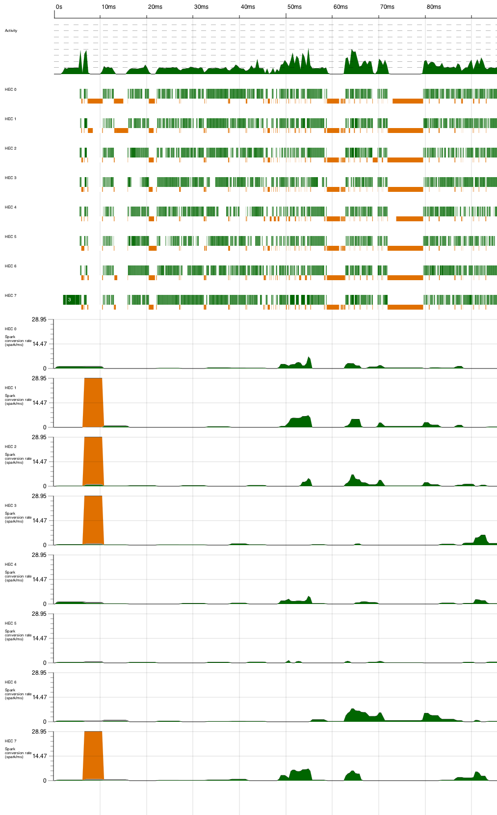
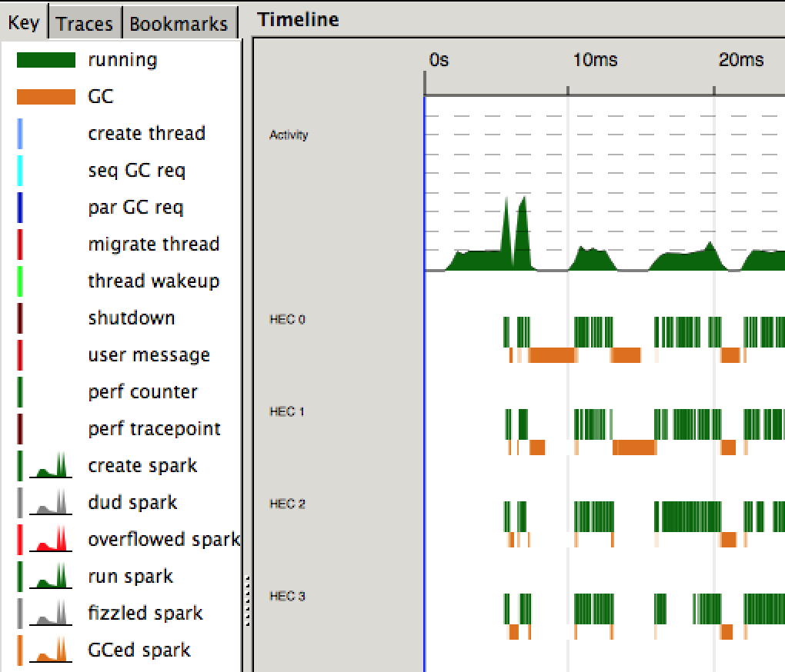
Data flow V.S. Equational reasoning & Lazy evaluation

Slide 31
Data flow V.S. Equational reasoning & Lazy evaluation
main = do
let distMap = computeDistances strings
evaluate distMap -- evalutes argument to WNF
let state’ = EM.em_restarts … distMap
em_restarts … distMap =
argmin variance states
where states = parMap rdeepseq runEM
runEM = em . initEMState … distMap
SPARKS: 2653 (1802 converted, 0 overflowed, 0 dud, 8 GC’d 825 fizzled)

Slide 32
Data flow V.S. Equational reasoning & Lazy evaluation
main = do
let distMap = computeDistances strings
-- evalute distMap
let state’ = EM.em_restarts … distMap
ComputeDistances.hs
comD distanceDefinition a =
concat $ DT.traceEvent "STCOM" $ P.parMap P.rdeepseq (\n -> subDist distanceDefinition n a) [1..(length a)]
computeDistances distanceDefinition a =
list2Map $ comD distanceDefinition a
-- This doesn’t do the trick:
-- GC’d sparks goes down to 0, and there’s only one “STCOMMM” event.
-- Manifestation of Heisenberg Uncertainty Principle!?
computeDistances distanceDefinition a =
list2Map $ DT.traceEvent "STCOMMM" $ comD distanceDefinition a
$ ghc-events show sc.eventlog > log
$ grep -c "STCOM” log
5

Slide 33
Parallelism V.S. Function that’s best expressed imperatively
Write the function in C and use FFI
Well known caveats
Memory handling when sophisticated structures are passed between Haskell and C
If C function does not call back to Haskell, in a single threaded program, annotate it with unsafe; in a multithreaded program, experiment and profile
Less known caveats
Inside the C function, faithfully malloc and then free => Segfault!
Write the function in STMonad
Considerably less readable than the C version
85% of time spent is in GC
The unboxed version STUArray is a little faster than STArray. This validates the claim that unboxed objects are GC friendlier
Write the function using foldr
this can be mind boggling…
0.5 seconds, preferred!
STUArray: 25 seconds
STArray: 30 seconds

Slide 34
Take away ideas
Haskell parallelism

Slide 35
Haskell stands out in Visibility
ghc-events
Zero code needed, just a compiler option
Custom events support
threadscope
Activity of each and every CPU core across time
Spark creation and conversion across time

Slide 36
Be alert of common pitfalls
Eval monad
Remember to hold references to sparks
Remember to `force`
Par monad
runPar is an expensive call
Strategies
Keep an eye on your data flow dependencies and their lazy evaluations

Slide 37
It works on real world problems!
On the redis key problem
Single thread: 11.5 seconds
Multithreaded 8 core: 2.8 seconds
On the citation problem
Single thread: 24.2 seconds
Multithreaded 8 core: 6.5 seconds

Slide 38
References
Code
https://github.com/fumin/string-clustering
Datasets
Redis keys: Cardinalblue
Citation: http://people.cs.umass.edu/~mccallum/papers/multicoref2005s.pdf
Haskell
Parallel and Concurrent Programming in Haskell http://ofps.oreilly.com/titles/9781449335946/index.html
Real World Haskell http://book.realworldhaskell.org/

